Slide 1

Uncertainty-Aware Scheduling of Iceberg Maintenance
B.Tech. · Semester V · UE24CS320A
END SEMESTER ASSESSMENT
Predictive and Uncertainty-Aware Scheduling of Apache Iceberg Storage Maintenance Under Concurrent Analytical Workloads
Project ID PW_25_PKA_02
Guide Dr. Prafullata Kiran Auradkar
Shashank Keshava Murthy · PES1UG24CS434
Shashank D · PES1UG24CS433
Prachi Jalan · PES1UG24CS326
Samarth Rajesh Rao · PES1UG24AM244
01
SHASHANK KESHAVA MURTHY · SHASHANK D · PRACHI JALAN · SAMARTH RAJESH RAO
Notes:
Project title, guide and project ID taken from submitted Review 2. Team SRNs supplied directly by the team.

Slide 2
Uncertainty-Aware Scheduling of Iceberg Maintenance
Outline
Problem, implementation and evidence
Why compaction timing is worth studying; what Phase 1 aims to establish.
Architecture, datasets and the responsibilities of the A/B/C components.
Actual execution screenshots, historical results and what they do not prove.
Review feedback addressed, remaining limitations and next work.
02
SHASHANK KESHAVA MURTHY · SHASHANK D · PRACHI JALAN · SAMARTH RAJESH RAO

Slide 3
Uncertainty-Aware Scheduling of Iceberg Maintenance
Abstract
Choose maintenance time using workload and queue information
Compaction combines small files, but it competes with analytical queries for resources.
We built a remote Spark/Iceberg testbed with trace-driven requests, observation and audit tools.
We compare learned estimators with simple baselines before claiming that a learned timing policy is useful.
Current outcome: implementation and diagnostic progress; no accepted SF10 learned scheduling advantage.
03
SHASHANK KESHAVA MURTHY · SHASHANK D · PRACHI JALAN · SAMARTH RAJESH RAO
Notes:
Reuses the central problem framing from Review 2; timing and uncertainty remain goals, not demonstrated benefits.

Slide 4
Uncertainty-Aware Scheduling of Iceberg Maintenance
Suggestions from Review 1 and Review 2
Make the work visible and explain the dataset
Panel feedback
What we prepared
Review 1: explain TPC-H structure
Eight tables, column counts, verified SF10 rows and a clear Snowset/SQL mapping.
Review 2: show actual screenshots and what has started
Labelled process, Spark UI, dashboard and audit screenshots with an explanation beside each.
The evidence demonstrates that the project has started; it does not turn an incomplete experiment into a successful result.
04
SHASHANK KESHAVA MURTHY · SHASHANK D · PRACHI JALAN · SAMARTH RAJESH RAO
Notes:
Review 1 TPC-H feedback is recorded in submitted Review 2. Review 2 remark supplied by the user in this task. No other panel remarks inferred.

Slide 5
Uncertainty-Aware Scheduling of Iceberg Maintenance
Understanding of the Problem
Response time includes waiting, not just query execution
Why maintain?
Why choose a time?
What must improve?
Too many files can add planning and file-access work. Compaction changes the layout.
The rewrite may compete with queries. A low-load opportunity may be better than a busy period.
Arrival-to-result response, with completed work and remaining maintenance accounted for.
05
SHASHANK KESHAVA MURTHY · SHASHANK D · PRACHI JALAN · SAMARTH RAJESH RAO

Slide 6
Uncertainty-Aware Scheduling of Iceberg Maintenance
Objectives and Scope
Test the timing hypothesis before adding model complexity
Build a reproducible Spark-on-Iceberg execution and measurement foundation.
Compare simple medians, shared estimators and separate A/B latency candidates on whole workload families.
Use C to forecast offered arrivals from past observations; measure its value and overhead.
Evaluate start-now, wait or defer choices only after fresh physical evidence passes its gates.
06
SHASHANK KESHAVA MURTHY · SHASHANK D · PRACHI JALAN · SAMARTH RAJESH RAO

Slide 7
Uncertainty-Aware Scheduling of Iceberg Maintenance
Dataset Description
TPC-H supplies the data and SQL; Snowset supplies arrival timing
TPC-H
Snowset
Controlled workload
Eight related tables and 61 columns. Our verified SF10 lineitem table contains 59,986,052 rows.
Recorded arrival timestamps set request spacing. The original Snowflake SQL and schema are not replayed.
Six TPC-H-derived SQL templates are assigned to arrivals. This is not the full official 22-query benchmark.
07
SHASHANK KESHAVA MURTHY · SHASHANK D · PRACHI JALAN · SAMARTH RAJESH RAO
Notes:
TPC-H specification https://www.tpc.org/tpc_documents_current_versions/pdf/tpc-h_v3.0.1.pdf ; Snowset https://github.com/resource-disaggregation/snowset ; six-template workload is a controlled mapping, not production SQL replay.

Slide 8
Uncertainty-Aware Scheduling of Iceberg Maintenance
TPC-H Structure
Eight linked tables form a wholesale business dataset
Table
Columns
SF10 rows
region / nation
3 / 4
5 / 25
supplier / customer
7 / 8
100,000 / 1,500,000
part / partsupp
9 / 5
2,000,000 / 8,000,000
orders / lineitem
9 / 16
15,000,000 / 59,986,052
08
SHASHANK KESHAVA MURTHY · SHASHANK D · PRACHI JALAN · SAMARTH RAJESH RAO
Notes:
Actual counts: results/three_model_sf10_scratch_recovery_20261025_03/prepare/result.json.

Slide 9
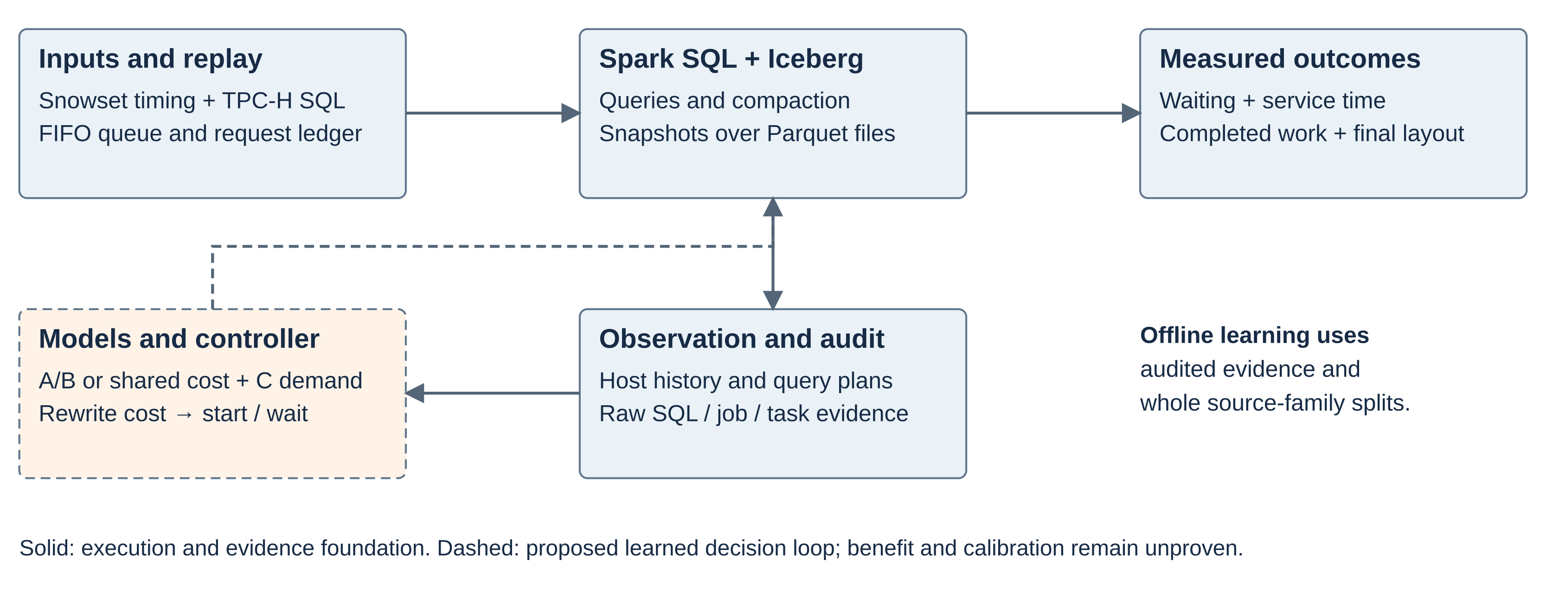
Uncertainty-Aware Scheduling of Iceberg Maintenance
Proposed Architecture
The execution path is separate from the learned decision loop
09
SHASHANK KESHAVA MURTHY · SHASHANK D · PRACHI JALAN · SAMARTH RAJESH RAO
Notes:
See editable SVG option A. Dashed paths are exploratory/proposed. No current scheduler acceptance is implied.

Slide 10
Uncertainty-Aware Scheduling of Iceberg Maintenance
Model Responsibilities
A/B estimate service time; C estimates future demand
Component
Output
Important boundary
A
Service time with request pending
Pending ≠ measured causal interference
B
Service time without request pending
Conditioned on actual physical layout
Shared comparator
Service time + state as an input
Same evidence splits and predictor budget
C
Future offered arrival count
Counts ≠ CPU load; past-only inputs
Rewrite estimate
Duration and layout transition
Separate measured target
10
SHASHANK KESHAVA MURTHY · SHASHANK D · PRACHI JALAN · SAMARTH RAJESH RAO
Notes:
three_model_maintenance/contracts.py; README.md; runtime acceptance remains blocked.

Slide 11
Uncertainty-Aware Scheduling of Iceberg Maintenance
Available Inputs
22 registered SF10 candidate inputs, all available before a decision
Query and layout
Queue and state
Host history
Query identity; file count, row count and bytes; eight query-plan operator counts.
Current queue depth and whether the maintenance client request is pending.
CPU, memory, read and write rates for both 60-second and 300-second windows.
Missing or unavailable history is not filled in. Post-query outcomes do not become predictors.
11
SHASHANK KESHAVA MURTHY · SHASHANK D · PRACHI JALAN · SAMARTH RAJESH RAO
Notes:
contracts.py: 14 base features; training/sf10_comparison.py: 8 plan operator counts. These are candidate inputs, not an SF10 trained-model claim.

Slide 12
Uncertainty-Aware Scheduling of Iceberg Maintenance
Implementation Progress
A working foundation with explicit acceptance boundaries
Built or observed
Current boundary
Remote Spark/Iceberg, replay and queue ledger
Real execution and recorded offered/completed/queued work
Observation, archive, receipts and hashes
Full SF10 acceptance remains blocked
Exploratory A/B/shared models and medians
SF1 development artifacts; no calibrated scheduler
SF10 ingestion and separate compaction capability
64 → 4 files in a capability run; not a policy win
12
SHASHANK KESHAVA MURTHY · SHASHANK D · PRACHI JALAN · SAMARTH RAJESH RAO
Notes:
Source: three_model_maintenance/README.md; saved fit04 review; failed archive03 result.

Slide 13
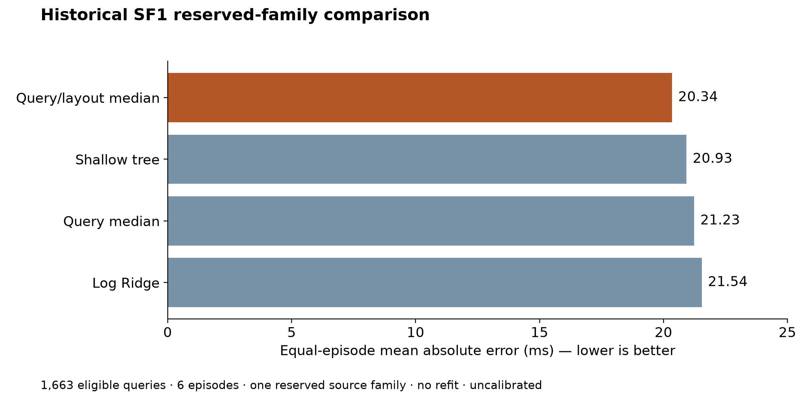
Uncertainty-Aware Scheduling of Iceberg Maintenance
Historical SF1 Results
The strongest simple baseline beat the learned query models
What this tells us
18 historical SF1 episodes; 9,923 query labels across three families.
Reserved test: 1,663 eligible calls. These are prediction errors, not scheduling benefit.
13
SHASHANK KESHAVA MURTHY · SHASHANK D · PRACHI JALAN · SAMARTH RAJESH RAO
Notes:
results/consistent_reserved_evaluation_20261017/result.json. No refit. One reserved family, six episodes, 1,663 eligible queries. Test family consumed.

Slide 14
Uncertainty-Aware Scheduling of Iceberg Maintenance
Exploratory Model Training
The A/B pipeline trained and reloaded real candidate artifacts
What ran
What data supported it
What remains open
Raw verification → frozen specification → fit → artifact reload audit. Ridge and shallow-tree bundles were saved.
335 complete-history SF1 calls: 16 pending-maintenance A and 319 nonpending B. One development family.
Different layouts confound the states. This fit does not establish held-out accuracy, uncertainty or causal slowdown.
14
SHASHANK KESHAVA MURTHY · SHASHANK D · PRACHI JALAN · SAMARTH RAJESH RAO
Notes:
three_model_maintenance/docs/reviews/FIRST_DEVELOPMENT_FIT04_2026-10-22.md. Actual worker3 four-stage pipeline completed; own-training diagnostics only.

Slide 15
Uncertainty-Aware Scheduling of Iceberg Maintenance
Implementation Evidence
How to read the screenshots
Eight original images show four views captured twice on November 11.
A live process listing proves a service was running at capture time. Spark was idle during these captures.
The dashboard and audit show the historical failed SF10 control; they are not accepted training evidence.
Each following view has a labelled explanation. Full originals and exact crops accompany the deck.
15
SHASHANK KESHAVA MURTHY · SHASHANK D · PRACHI JALAN · SAMARTH RAJESH RAO
Notes:
Original capture_manifest.jsonl and source snapshots retained. Capture group A 20:15 IST and B 22:26 IST, 11 Nov 2026. All are historical after capture.

Slide 16
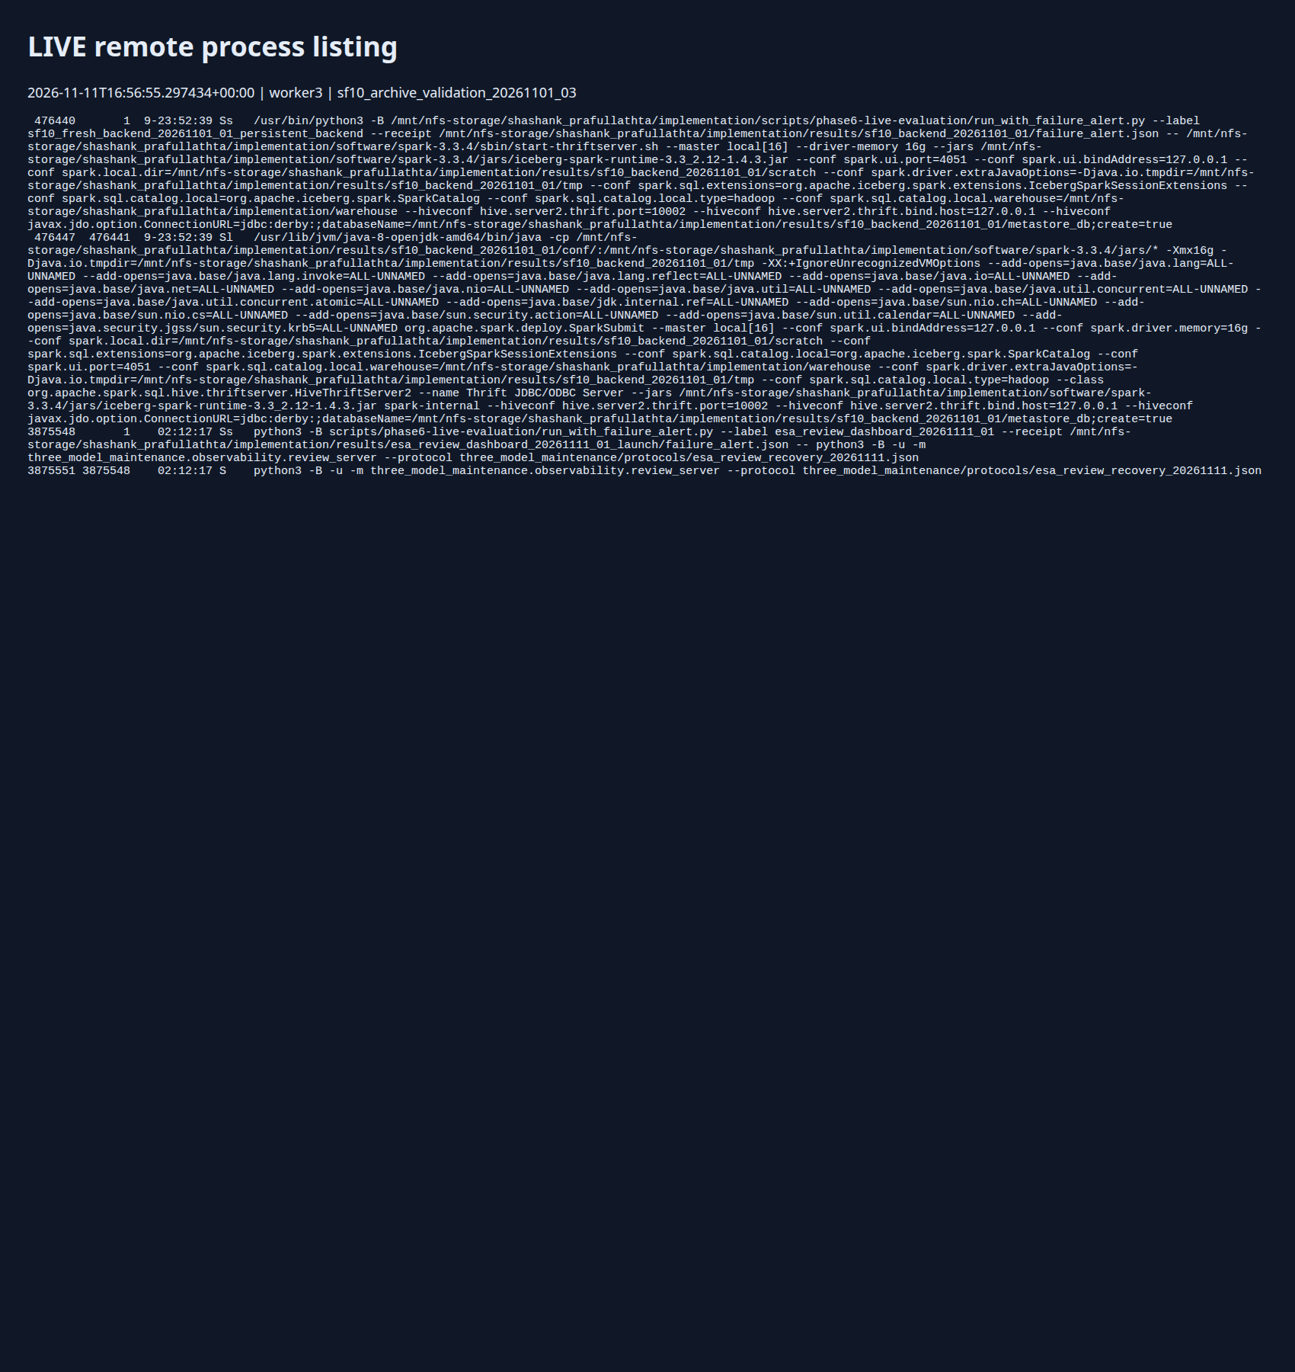
Uncertainty-Aware Scheduling of Iceberg Maintenance
Recorded Execution · B01
Remote Spark and monitoring processes
11 November 2026, 22:26 IST
The process list shows the Spark launcher, Java execution process and our read-only review server on worker3. It establishes that the remote software stack was running when captured. It does not show an active training or compaction experiment.
Historical capture. No experiment was running.
16
SHASHANK KESHAVA MURTHY · SHASHANK D · PRACHI JALAN · SAMARTH RAJESH RAO
Notes:
Original: /media/shashank/Data1/PDocuments/Capstone/implementation/docs/Review/ESA review 26/screenshots/20261111T165654_854006Z__sf10_archive_validation_20261101_03__LIVE_processes.png
SHA256 66e31d4e6ba69dd2492741c051038b811394f2672b28ac7fba972e00a58e490e
Capture 11 November 2026, 22:26 IST
The process list shows the Spark launcher, Java execution process and our read-only review server on worker3. It establishes that the remote software stack was running when captured. It does not show an active training or compaction experiment.

Slide 17
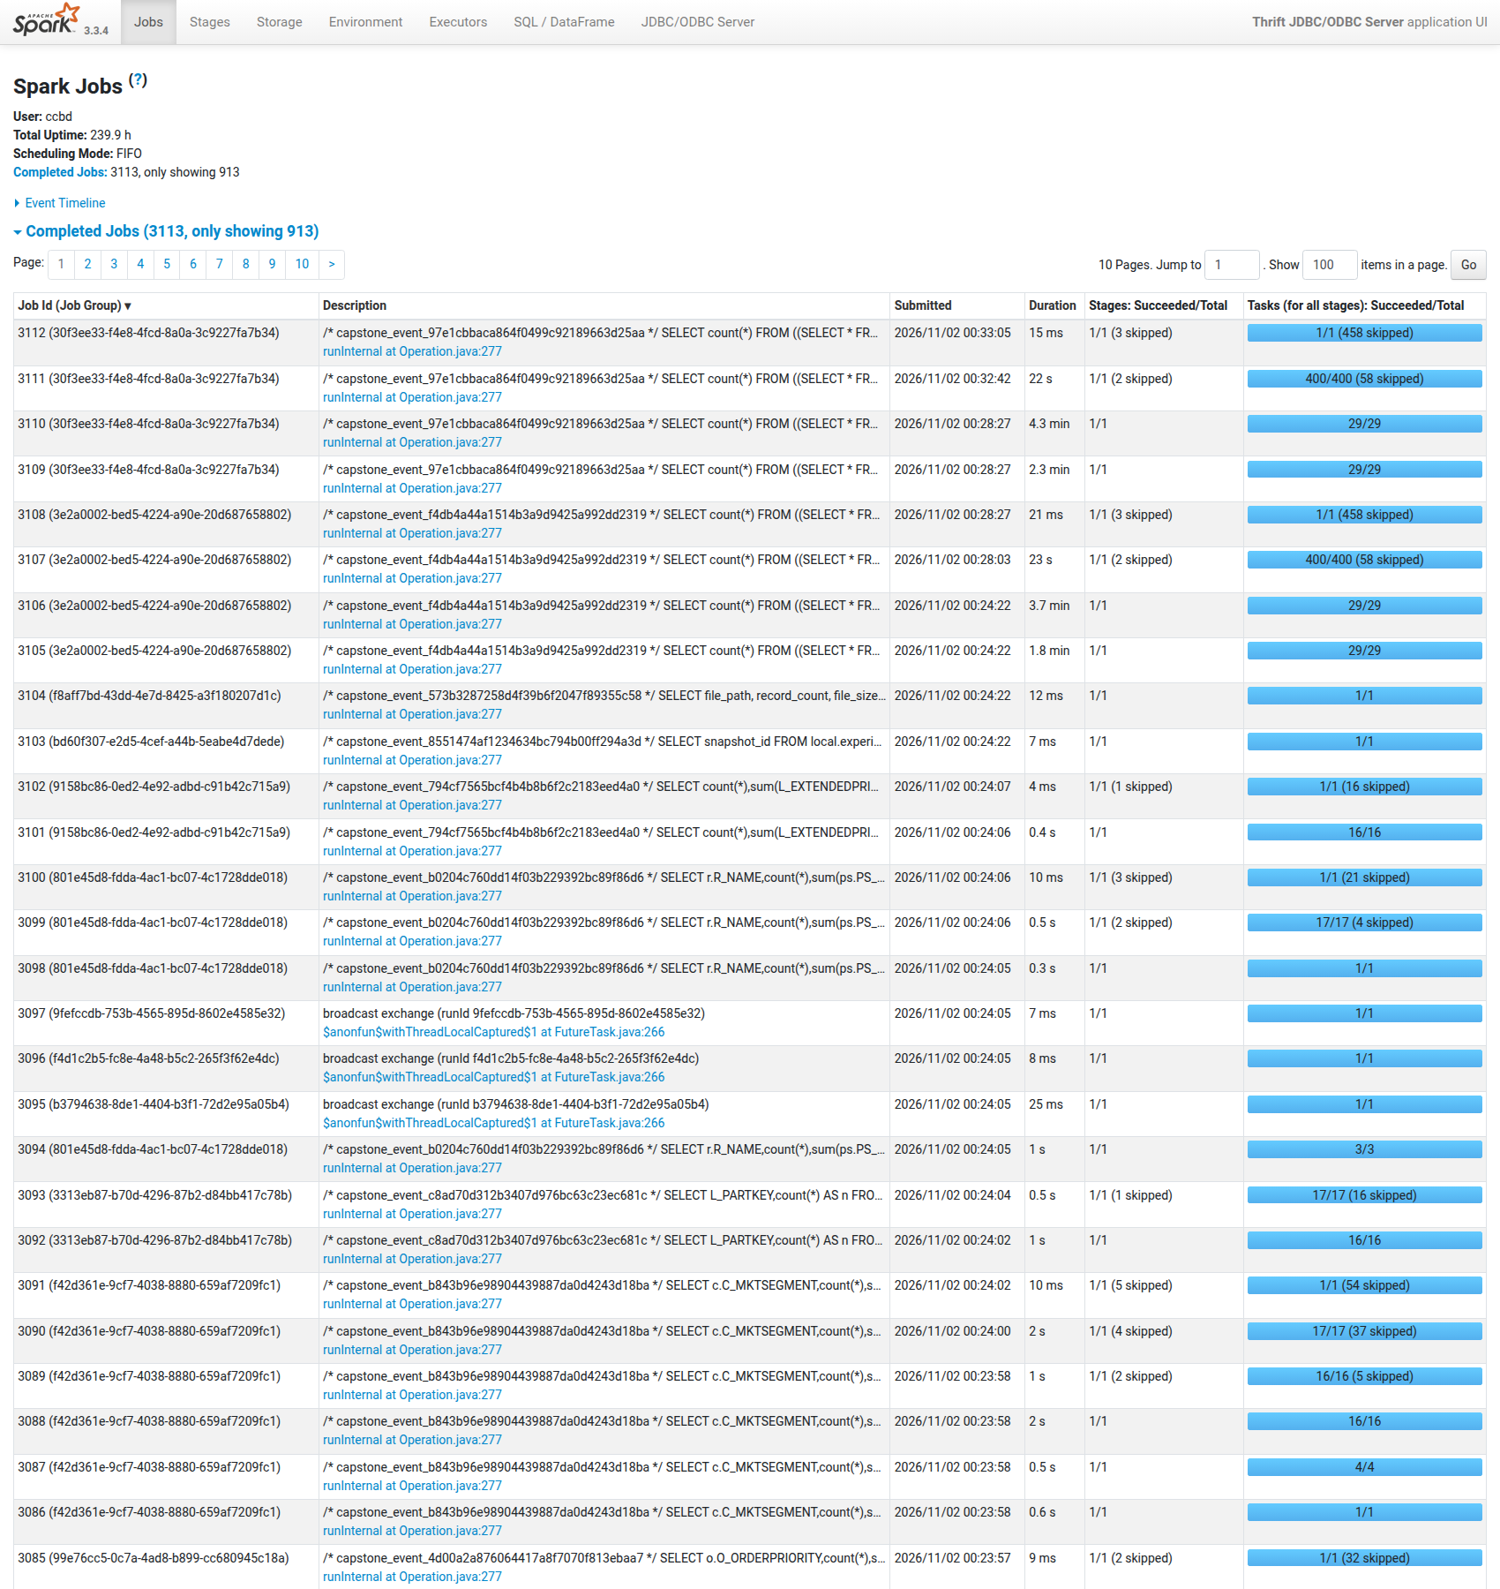
Uncertainty-Aware Scheduling of Iceberg Maintenance
Recorded Execution · B02
Spark UI and completed execution history
11 November 2026, 22:26 IST
The Spark UI lists completed jobs with SQL descriptions, submission times, durations and successful task counts. The application reports 3,113 completed jobs and only 913 displayed in its retained view. These are application-level totals, not counts of independent experiments or accepted training examples.
Historical capture. No experiment was running.
17
SHASHANK KESHAVA MURTHY · SHASHANK D · PRACHI JALAN · SAMARTH RAJESH RAO
Notes:
Original: /media/shashank/Data1/PDocuments/Capstone/implementation/docs/Review/ESA review 26/screenshots/20261111T165654_854006Z__sf10_archive_validation_20261101_03__LIVE_Spark_UI_historical_jobs.png
SHA256 e303c7693f4daeb06a3e6d31253ef092229f31ec5d3ee7b583216649412a121e
Capture 11 November 2026, 22:26 IST
The Spark UI lists completed jobs with SQL descriptions, submission times, durations and successful task counts. The application reports 3,113 completed jobs and only 913 displayed in its retained view. These are application-level totals, not counts of independent experiments or accepted training examples.

Slide 18
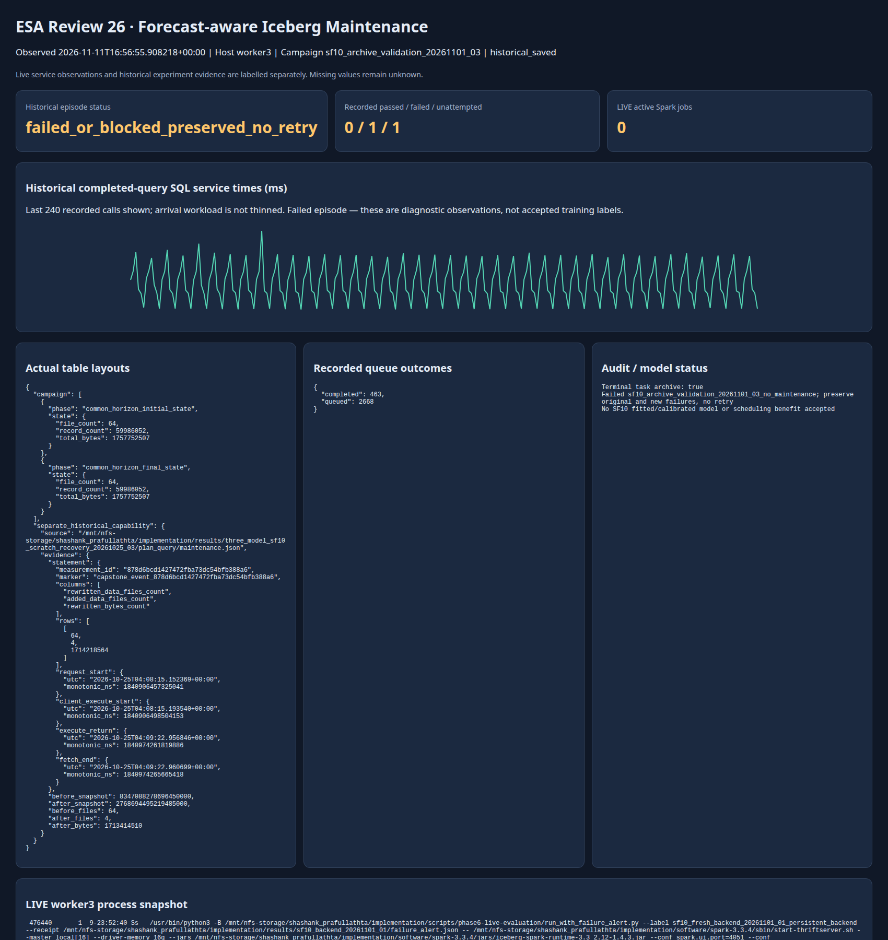
Uncertainty-Aware Scheduling of Iceberg Maintenance
Recorded Execution · B03
Recorded SF10 workload and table state
11 November 2026, 22:26 IST
The dashboard combines a live service observation with explicitly historical experiment data. The failed control recorded 463 completed calls and 2,668 queued requests. Initial and final table state remained at 64 files and 59,986,052 rows. The graph shows the last 240 recorded service times; it is not a policy comparison.
Historical capture. No experiment was running.
18
SHASHANK KESHAVA MURTHY · SHASHANK D · PRACHI JALAN · SAMARTH RAJESH RAO
Notes:
Original: /media/shashank/Data1/PDocuments/Capstone/implementation/docs/Review/ESA review 26/screenshots/20261111T165654_854006Z__sf10_archive_validation_20261101_03__MIXED_live_service_historical_results.png
SHA256 53a349f840a4d710eeb3c4ecd4c84f659480cc3d6a6702a405891998d37d3b49
Capture 11 November 2026, 22:26 IST
The dashboard combines a live service observation with explicitly historical experiment data. The failed control recorded 463 completed calls and 2,668 queued requests. Initial and final table state remained at 64 files and 59,986,052 rows. The graph shows the last 240 recorded service times; it is not a policy comparison.

Slide 19
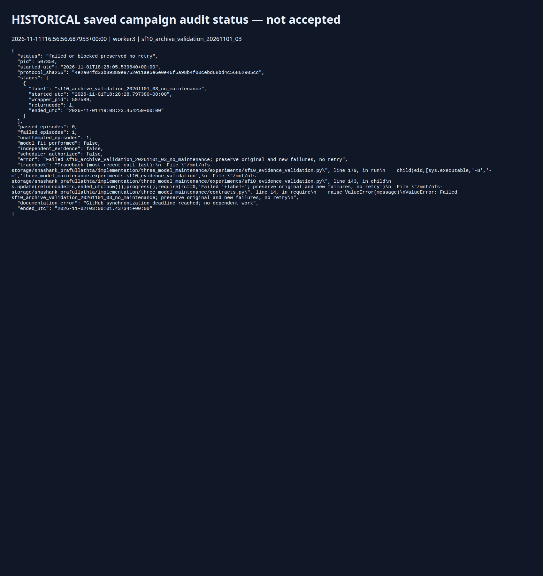
Uncertainty-Aware Scheduling of Iceberg Maintenance
Recorded Execution · B04
Preserved failed SF10 campaign
11 November 2026, 22:26 IST
The campaign ledger records zero passed episodes, one failed episode and one unattempted maintenance episode. Model fitting and scheduler authorization are false. A later ownership diagnostic identified the description-based attribution defect, but it did not retroactively pass this run.
Historical capture. No experiment was running.
19
SHASHANK KESHAVA MURTHY · SHASHANK D · PRACHI JALAN · SAMARTH RAJESH RAO
Notes:
Original: /media/shashank/Data1/PDocuments/Capstone/implementation/docs/Review/ESA review 26/screenshots/20261111T165654_854006Z__sf10_archive_validation_20261101_03__HISTORICAL_failed_audit.png
SHA256 dbfd71bb92c4bd9657bc21de1ab4d0b9265560a87bd52edf5acf7ebab4fe1adc
Capture 11 November 2026, 22:26 IST
The campaign ledger records zero passed episodes, one failed episode and one unattempted maintenance episode. Model fitting and scheduler authorization are false. A later ownership diagnostic identified the description-based attribution defect, but it did not retroactively pass this run.

Slide 20
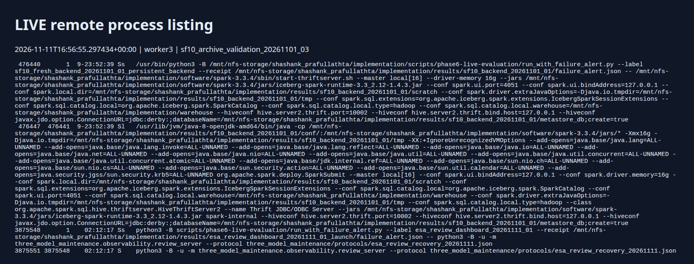
Uncertainty-Aware Scheduling of Iceberg Maintenance
Screenshot Detail
The runtime stack is visible in the process list
Python wrapper launches the backend.
Java runs Spark with Iceberg support.
The review server reads and displays evidence.
This confirms the execution environment was running. It does not show an active model fit.
20
SHASHANK KESHAVA MURTHY · SHASHANK D · PRACHI JALAN · SAMARTH RAJESH RAO
Notes:
Exact crop of B01; full original remains in Labelled evidence. No text altered.

Slide 21
Uncertainty-Aware Scheduling of Iceberg Maintenance
SF10 Compaction Capability
A separate historical run changed 64 files into 4
64 files
→
4 files
1,714,218,564 bytes reported rewritten in the saved procedure result.
This demonstrates actual layout rewriting, not improved query latency or better maintenance timing.
In the later failed control, no compaction ran and the layout correctly remained at 64 files.
21
SHASHANK KESHAVA MURTHY · SHASHANK D · PRACHI JALAN · SAMARTH RAJESH RAO
Notes:
Source results/three_model_sf10_scratch_recovery_20261025_03/plan_query/maintenance.json. This is separate from archive03 no-maintenance control.

Slide 22
Uncertainty-Aware Scheduling of Iceberg Maintenance
What Failed and What We Learned
The audit rejected generated jobs without the SQL marker
Original outcome
Diagnostic progress
Required repair
0 passed / 1 failed / 1 unattempted. The maintenance arm was not launched. No SF10 fit followed.
463 exact SQL matches. All 308 rejected job links belonged to those marked SQL executions. No unresolved links.
Capture direct SQL → job → stage → task ownership prospectively, while still rejecting unknown work.
The old run remains failed. Ownership diagnosis does not prove complete task evidence.
22
SHASHANK KESHAVA MURTHY · SHASHANK D · PRACHI JALAN · SAMARTH RAJESH RAO
Notes:
Failed result: results/sf10_archive_validation_20261101_03/result.json. Post-hoc diagnostic: results/sf10_sql_ownership_diagnostic_20261111_01/result.json.

Slide 23
Uncertainty-Aware Scheduling of Iceberg Maintenance
Applicability in Different Domains
Three potential settings with the same maintenance trade-off
Retail analytics
Financial reporting
Industrial analytics
Order and sales reports share the system with file maintenance. Bursty reporting demand creates timing choices.
Reconciliation and analytical queries can overlap with maintenance windows. Queue response and completion matter.
Sensor history accumulates in lakehouse tables. File consolidation may compete with interactive analysis.
These are proposed uses. Our measurements are from the controlled Spark/Iceberg benchmark.
23
SHASHANK KESHAVA MURTHY · SHASHANK D · PRACHI JALAN · SAMARTH RAJESH RAO
Notes:
Potential application domains, not experimentally validated deployments.

Slide 24
Uncertainty-Aware Scheduling of Iceberg Maintenance
Related Work
The comparison must be against strong existing approaches
Work
Relevant idea
Our remaining question
AutoComp
Automated table compaction
Queue-aware timing needs direct evaluation
SILK
Manage maintenance interference
Different LSM / resource-scheduler setting
Learned cost model
Plan-aware prediction for SQL routing
Prediction does not prove timing benefit
Smart Compaction
Metadata-based compaction utility
Metadata ML alone is not novelty
24
SHASHANK KESHAVA MURTHY · SHASHANK D · PRACHI JALAN · SAMARTH RAJESH RAO
Notes:
AutoComp https://arxiv.org/abs/2504.04186 ; SILK https://www.usenix.org/conference/atc19/presentation/balmau ; cross-engine cost model https://arxiv.org/abs/2506.02802 ; Smart Compaction https://arxiv.org/abs/2608.08639 .

Slide 25
Uncertainty-Aware Scheduling of Iceberg Maintenance
Phase 1 Conclusion
We have started the implementation and can show its evidence
Built: remote execution, dataset preparation, replay, observation, candidate training and monitoring.
Observed: historical SF1 comparison and separate SF10 compaction capability.
Diagnosed: a concrete SQL-job attribution defect in the failed SF10 campaign.
Still pending: fresh accepted SF10 pair, independent calibration and a demonstrated scheduling advantage.
25
SHASHANK KESHAVA MURTHY · SHASHANK D · PRACHI JALAN · SAMARTH RAJESH RAO

Slide 26
Uncertainty-Aware Scheduling of Iceberg Maintenance
Next Work
Repair, validate, then compare on fresh evidence
1 Attribution repair
2 Fresh matched comparison
3 Model and policy evaluation
Record direct SQL/job membership and complete task evidence. Validate without weakening the foreign-work gate.
Register new source windows and tables. Run control and compaction with equivalent workload accounting.
Compare medians, shared and separate estimators; test forecasting and total online overhead.
26
SHASHANK KESHAVA MURTHY · SHASHANK D · PRACHI JALAN · SAMARTH RAJESH RAO

Slide 27
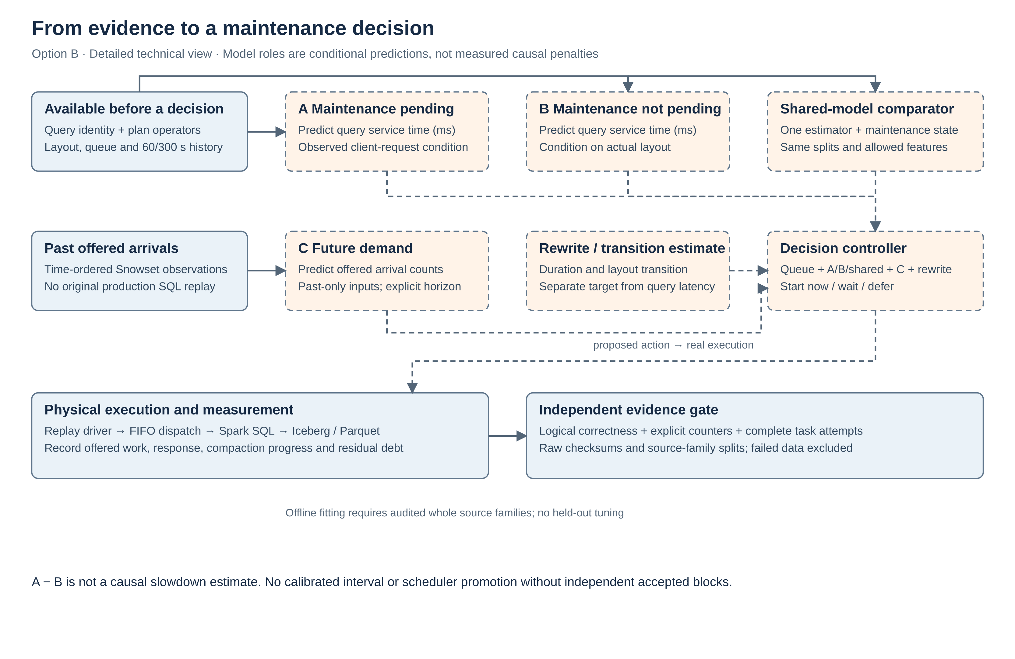
Uncertainty-Aware Scheduling of Iceberg Maintenance
Architecture Option B
Detailed model and evidence contract
27
SHASHANK KESHAVA MURTHY · SHASHANK D · PRACHI JALAN · SAMARTH RAJESH RAO
Notes:
Alternative editable architecture, not another accepted implementation.

Slide 28
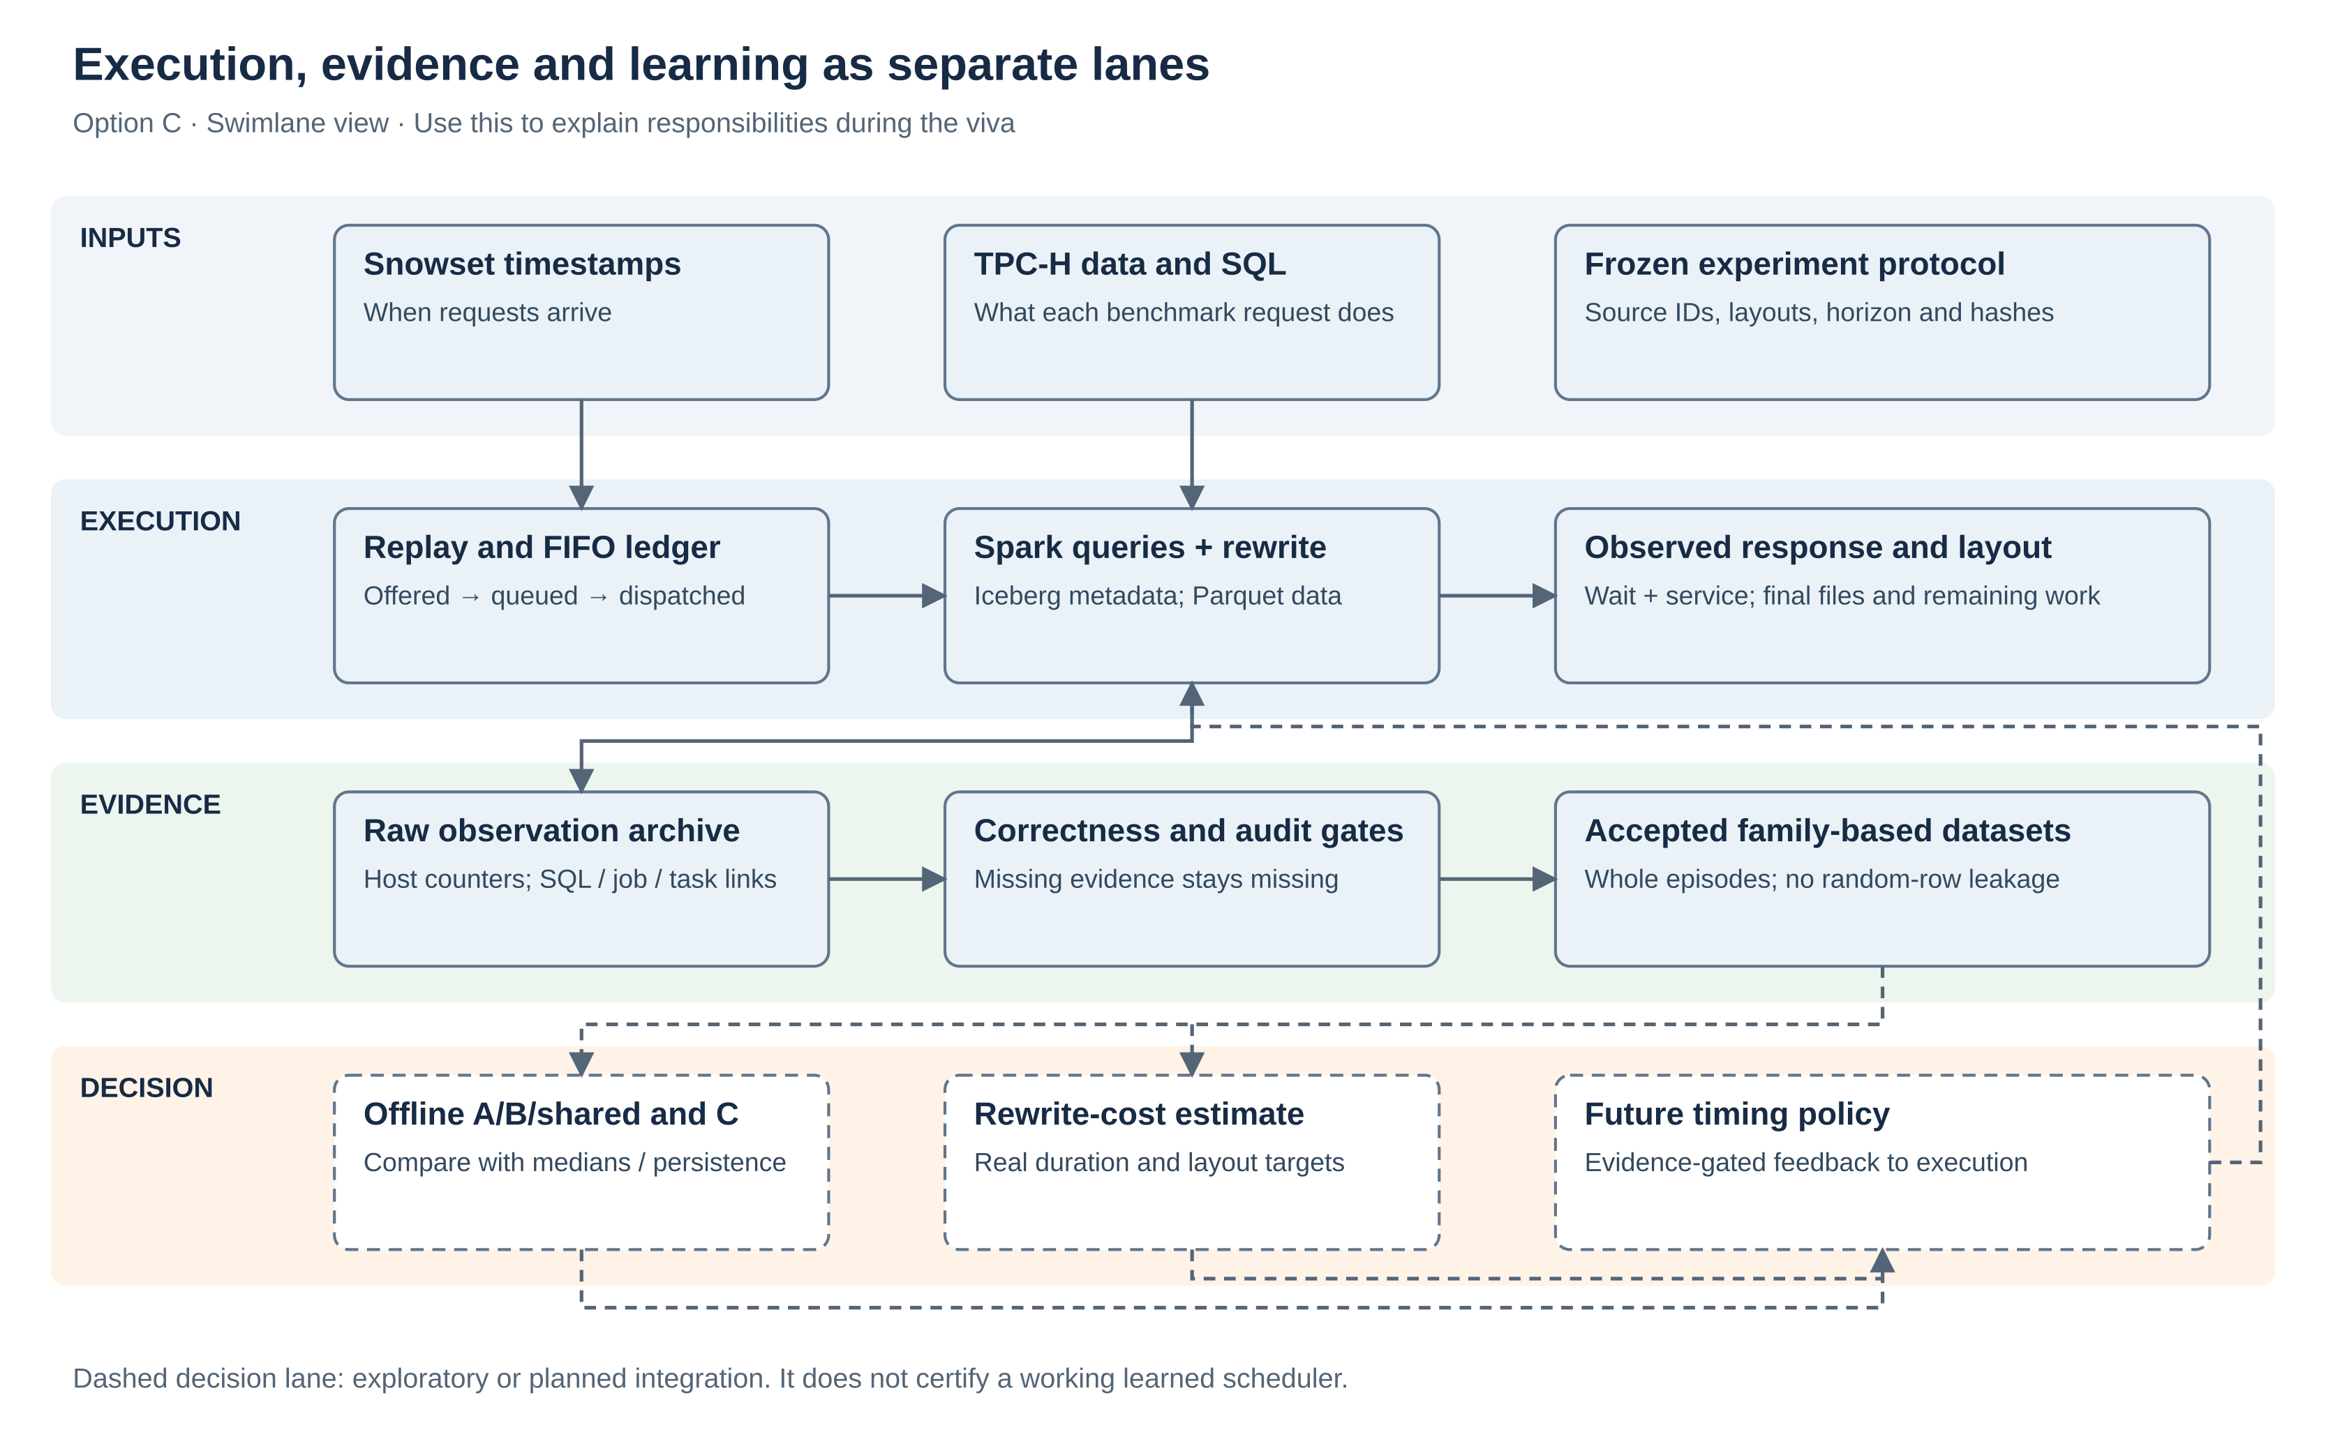
Uncertainty-Aware Scheduling of Iceberg Maintenance
Architecture Option C
Explain the system as four responsibility lanes
28
SHASHANK KESHAVA MURTHY · SHASHANK D · PRACHI JALAN · SAMARTH RAJESH RAO
Notes:
Alternative editable architecture for viva discussion.

Slide 29

Uncertainty-Aware Scheduling of Iceberg Maintenance
Earlier Capture · A01
Remote Spark and monitoring processes
11 November 2026, 20:15 IST
The process list shows the Spark launcher, Java execution process and our read-only review server on worker3. It establishes that the remote software stack was running when captured. It does not show an active training or compaction experiment.
Earlier observation of the same system; not another experiment.
29
SHASHANK KESHAVA MURTHY · SHASHANK D · PRACHI JALAN · SAMARTH RAJESH RAO
Notes:
Earlier original: /media/shashank/Data1/PDocuments/Capstone/implementation/docs/Review/ESA review 26/screenshots/20261111T144523_775189Z__sf10_archive_validation_20261101_03__LIVE_processes.png
SHA256 2d3fa3330e86f488481dc4bc62973e830f58f54d51281246025e55f23733f491
The process list shows the Spark launcher, Java execution process and our read-only review server on worker3. It establishes that the remote software stack was running when captured. It does not show an active training or compaction experiment.

Slide 30

Uncertainty-Aware Scheduling of Iceberg Maintenance
Earlier Capture · A02
Spark UI and completed execution history
11 November 2026, 20:15 IST
The Spark UI lists completed jobs with SQL descriptions, submission times, durations and successful task counts. The application reports 3,113 completed jobs and only 913 displayed in its retained view. These are application-level totals, not counts of independent experiments or accepted training examples.
Earlier observation of the same system; not another experiment.
30
SHASHANK KESHAVA MURTHY · SHASHANK D · PRACHI JALAN · SAMARTH RAJESH RAO
Notes:
Earlier original: /media/shashank/Data1/PDocuments/Capstone/implementation/docs/Review/ESA review 26/screenshots/20261111T144523_775189Z__sf10_archive_validation_20261101_03__LIVE_Spark_UI_historical_jobs.png
SHA256 6c2a574c647f7213053dd5414a5753f8a4656e2036b5cbaca3080688f2dbd371
The Spark UI lists completed jobs with SQL descriptions, submission times, durations and successful task counts. The application reports 3,113 completed jobs and only 913 displayed in its retained view. These are application-level totals, not counts of independent experiments or accepted training examples.

Slide 31

Uncertainty-Aware Scheduling of Iceberg Maintenance
Earlier Capture · A03
Recorded SF10 workload and table state
11 November 2026, 20:15 IST
The dashboard combines a live service observation with explicitly historical experiment data. The failed control recorded 463 completed calls and 2,668 queued requests. Initial and final table state remained at 64 files and 59,986,052 rows. The graph shows the last 240 recorded service times; it is not a policy comparison.
Earlier observation of the same system; not another experiment.
31
SHASHANK KESHAVA MURTHY · SHASHANK D · PRACHI JALAN · SAMARTH RAJESH RAO
Notes:
Earlier original: /media/shashank/Data1/PDocuments/Capstone/implementation/docs/Review/ESA review 26/screenshots/20261111T144523_775189Z__sf10_archive_validation_20261101_03__MIXED_live_service_historical_results.png
SHA256 b0bd66aa9f36f1aca266bcea9269e7c4a99e299fb8f7bc9d69b52c33b5643ee7
The dashboard combines a live service observation with explicitly historical experiment data. The failed control recorded 463 completed calls and 2,668 queued requests. Initial and final table state remained at 64 files and 59,986,052 rows. The graph shows the last 240 recorded service times; it is not a policy comparison.

Slide 32

Uncertainty-Aware Scheduling of Iceberg Maintenance
Earlier Capture · A04
Preserved failed SF10 campaign
11 November 2026, 20:15 IST
The campaign ledger records zero passed episodes, one failed episode and one unattempted maintenance episode. Model fitting and scheduler authorization are false. A later ownership diagnostic identified the description-based attribution defect, but it did not retroactively pass this run.
Earlier observation of the same system; not another experiment.
32
SHASHANK KESHAVA MURTHY · SHASHANK D · PRACHI JALAN · SAMARTH RAJESH RAO
Notes:
Earlier original: /media/shashank/Data1/PDocuments/Capstone/implementation/docs/Review/ESA review 26/screenshots/20261111T144523_775189Z__sf10_archive_validation_20261101_03__HISTORICAL_failed_audit.png
SHA256 f97cfcb8b8a4a44a4941bfee97bc9052787209d8b888cb1b30b4646f1b081915
The campaign ledger records zero passed episodes, one failed episode and one unattempted maintenance episode. Model fitting and scheduler authorization are false. A later ownership diagnostic identified the description-based attribution defect, but it did not retroactively pass this run.

Slide 33
Uncertainty-Aware Scheduling of Iceberg Maintenance
References and Evidence
Primary references and saved project records
TPC-H specification; Snowset source documentation; Spark 3.3.4 and Iceberg 1.4.3 documentation.
AutoComp (2025); SILK (2019); Strausz et al. cross-engine cost model (2025); Smart Compaction preprint (2026).
Historical reserved evaluation: consistent_reserved_evaluation_20261017.
SF10 capability, failed archive03, SQL ownership diagnostic and original screenshot manifest.
33
SHASHANK KESHAVA MURTHY · SHASHANK D · PRACHI JALAN · SAMARTH RAJESH RAO
Notes:
Full numbered bibliography and artifact paths are in the accompanying ESA report. Official source URLs checked during preparation.

Slide 34
Uncertainty-Aware Scheduling of Iceberg Maintenance
Thank You
Questions and demonstration
Work completed, evidence retained, limitations stated.
The report and screenshot index provide the source for every reported result.
34
SHASHANK KESHAVA MURTHY · SHASHANK D · PRACHI JALAN · SAMARTH RAJESH RAO

